Slide 1
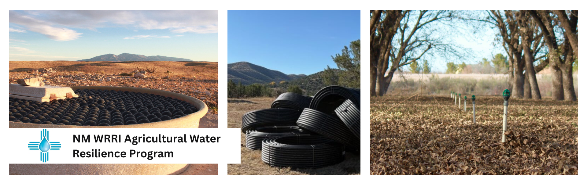


Informational Webinar
Wednesday May 20, 2026
3:00 – 4:30 pm MDT

Slide 2
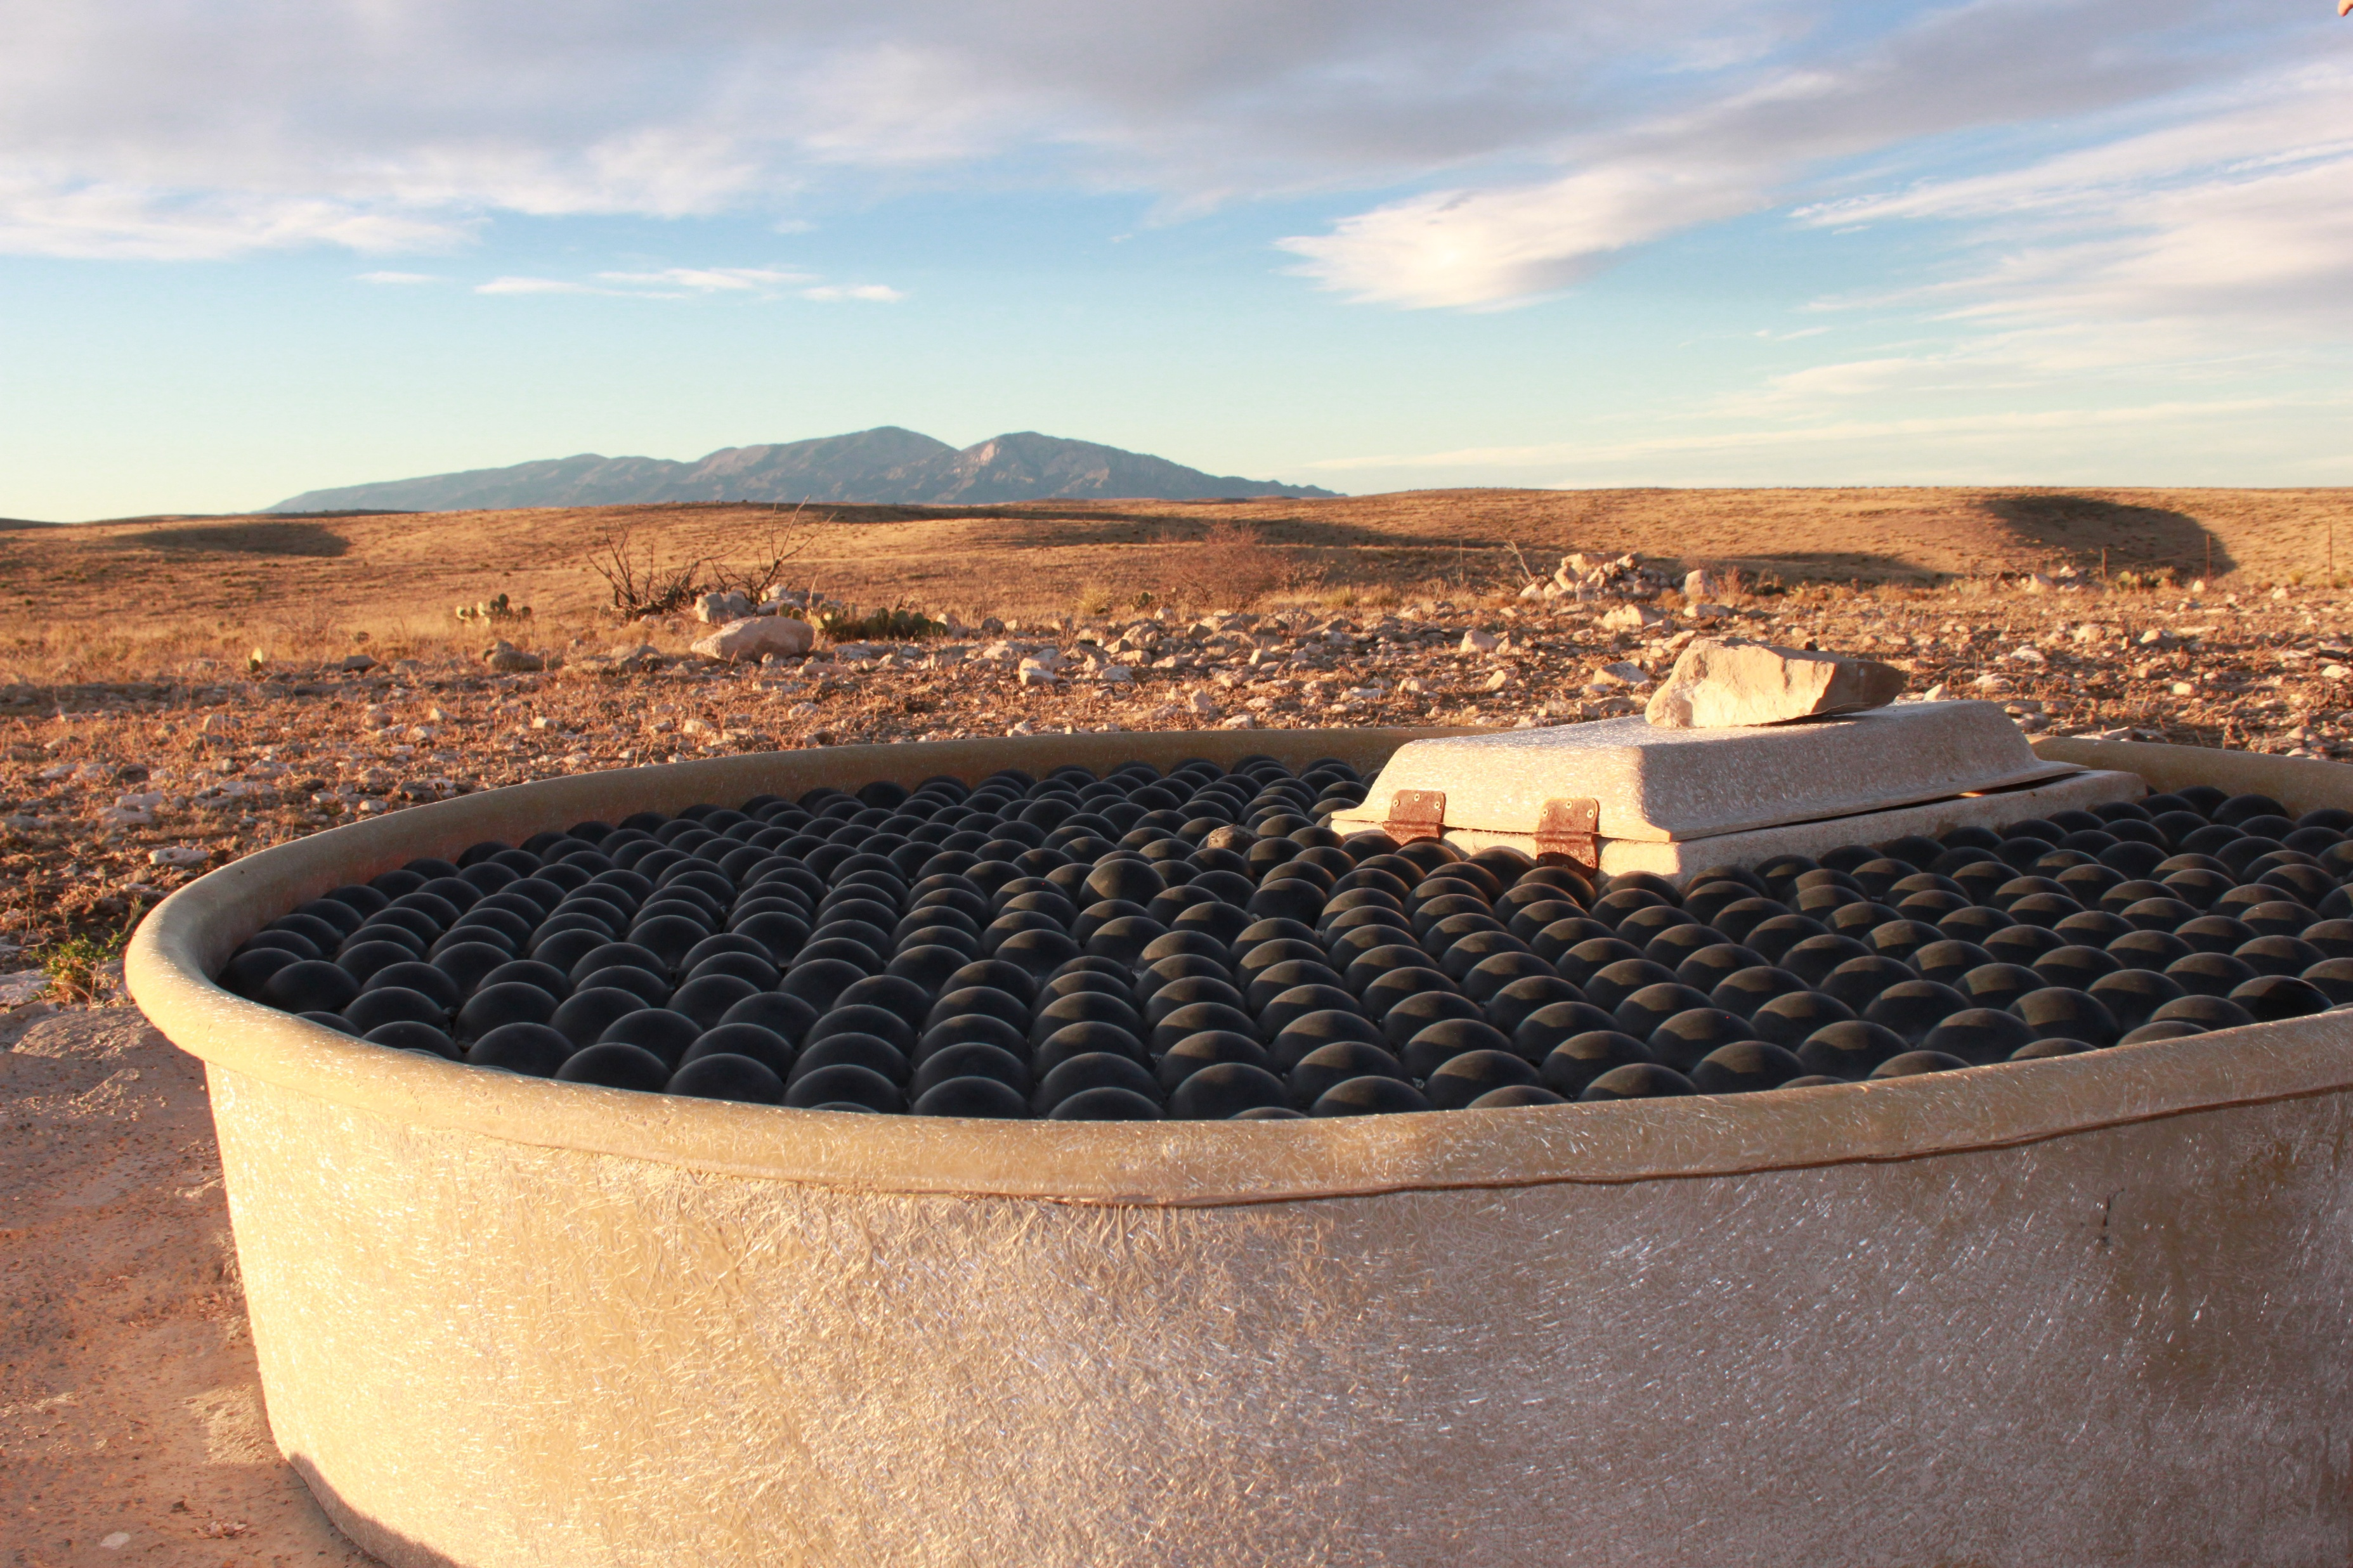
Outline
NM WRRI History & Mission
NM WRRI AgWRP Purpose
Application Criteria
Application Timeline
Application
Questions

Slide 3
NM WRRI History & Mission
The New Mexico Water Resources Research Institute (NM WRRI) is part of New Mexico State University (NMSU) in Las Cruces,
New Mexico. The New Mexico Legislature established NM WRRI in 1963, and it was approved under the 1964 federal Water Resources Research Act. NM WRRI’s mission is to develop and disseminate knowledge that will assist the state and nation in solving water problems.

Slide 4
NM WRRI AgWRP Purpose
The NM WRRI Agricultural Water Resilience Program implements in part Action A2 of the New Mexico 50-Year Water Action Plan to incentivize agricultural water conservation. The goal of this action is to maintain the resilience of agriculture with less water. To achieve this goal, NM WRRI will implement projects that improve farmers’ and ranchers’ ability to manage, save, and efficiently apply limited water resources for agricultural production.
Projects: NM WRRI will award funding to implement on-the-ground projects by ranchers and farmers partnered with eligible applicants. All project expenditures must be expended between September 1, 2026, and June 30, 2027.
Water Impact Assessment: NM WRRI will monitor and assess the impact of projects on water efficiency and resilience for an additional year following the awarded performance period.

Slide 5
General NM WRRI AgWRP Performance Metrics
Number of Watersheds Impacted
Projected Amount of Water Saved
Agricultural Acreage
Number of Farms and Ranches Benefited

Slide 6
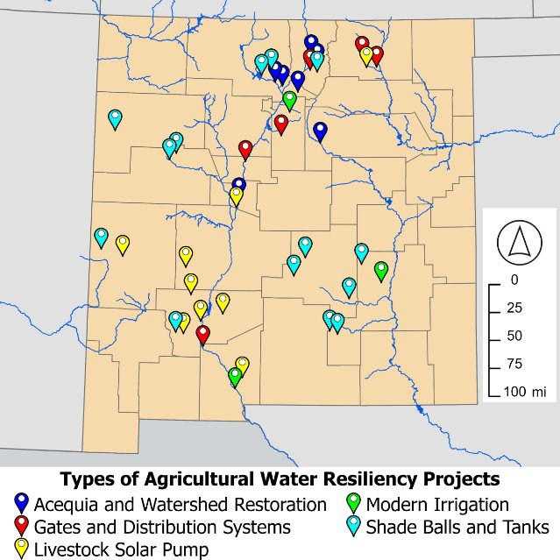
FY 26 AgWRP Funded Projects
41 funded projects
Budgeted amount
  $4.5M with projects up to $250,000
  $0.5M project administration and research
NM WRRI/NMDA have been named leads for NM 50 year water action plan section A2 to incentivize agricultural water conservation and develop dashboard

Slide 7
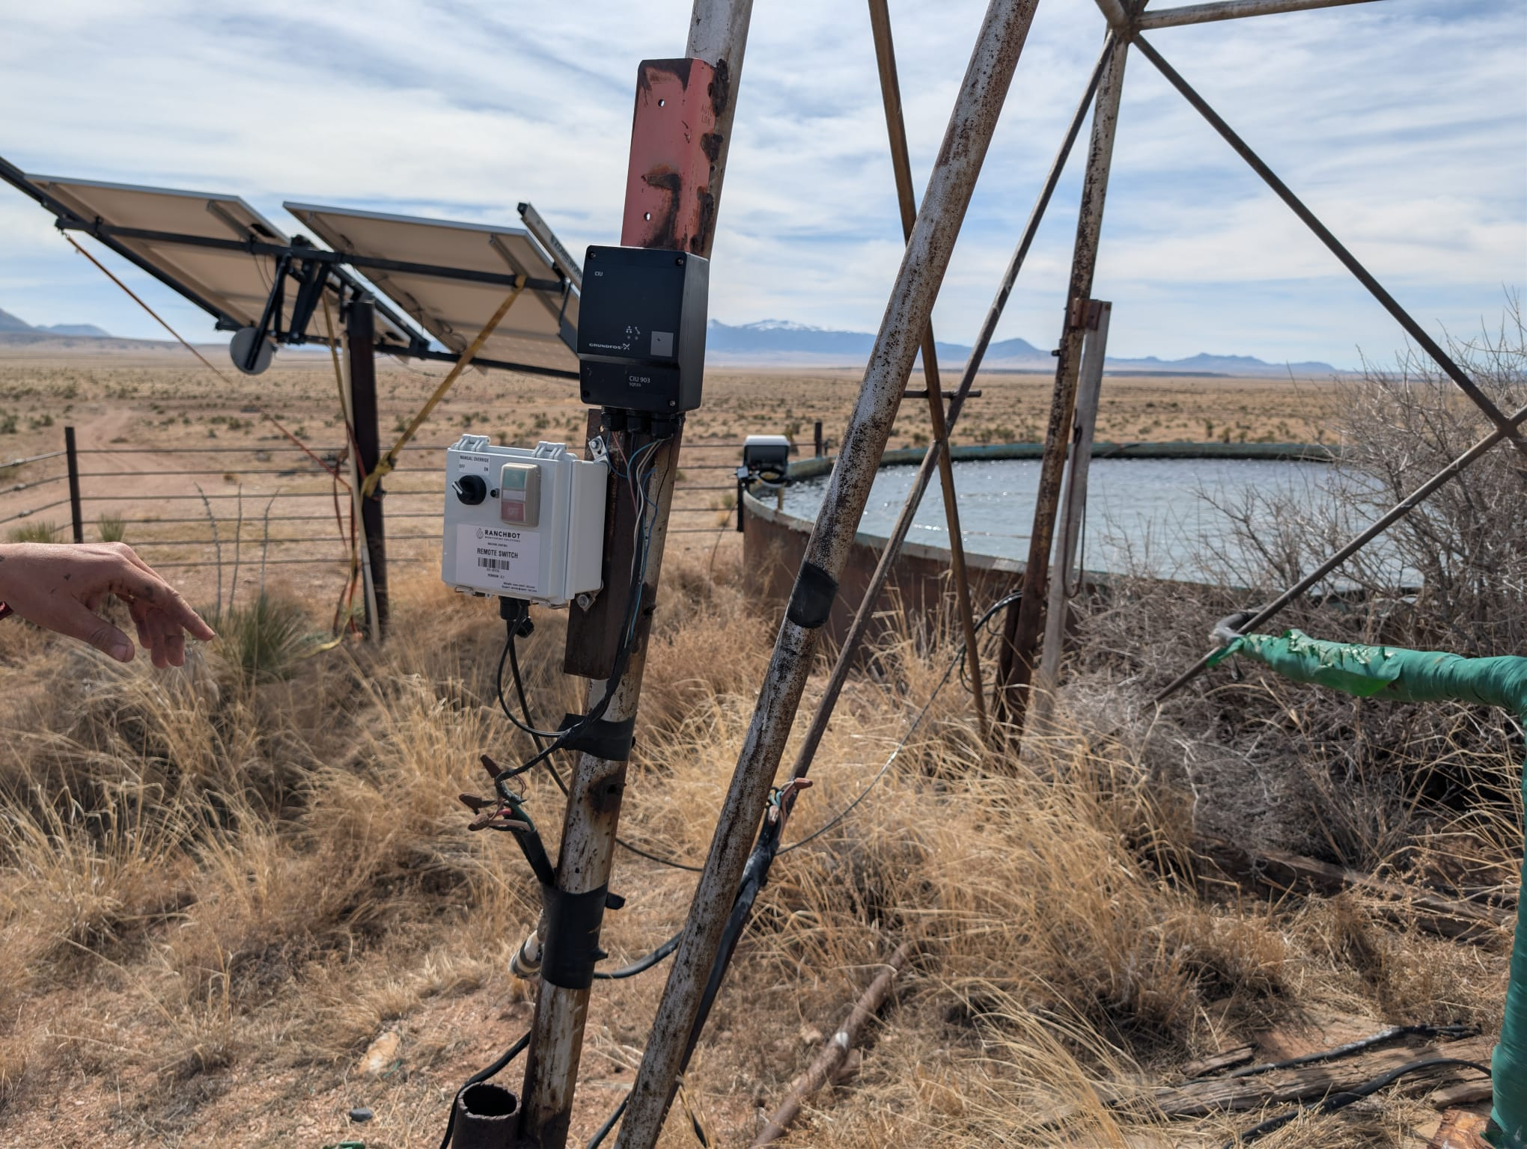
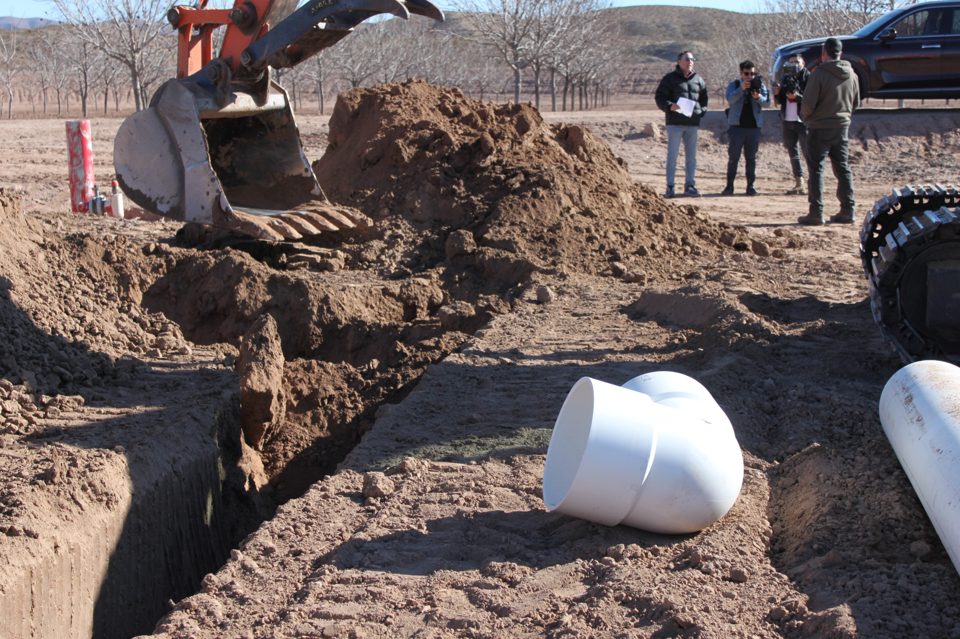
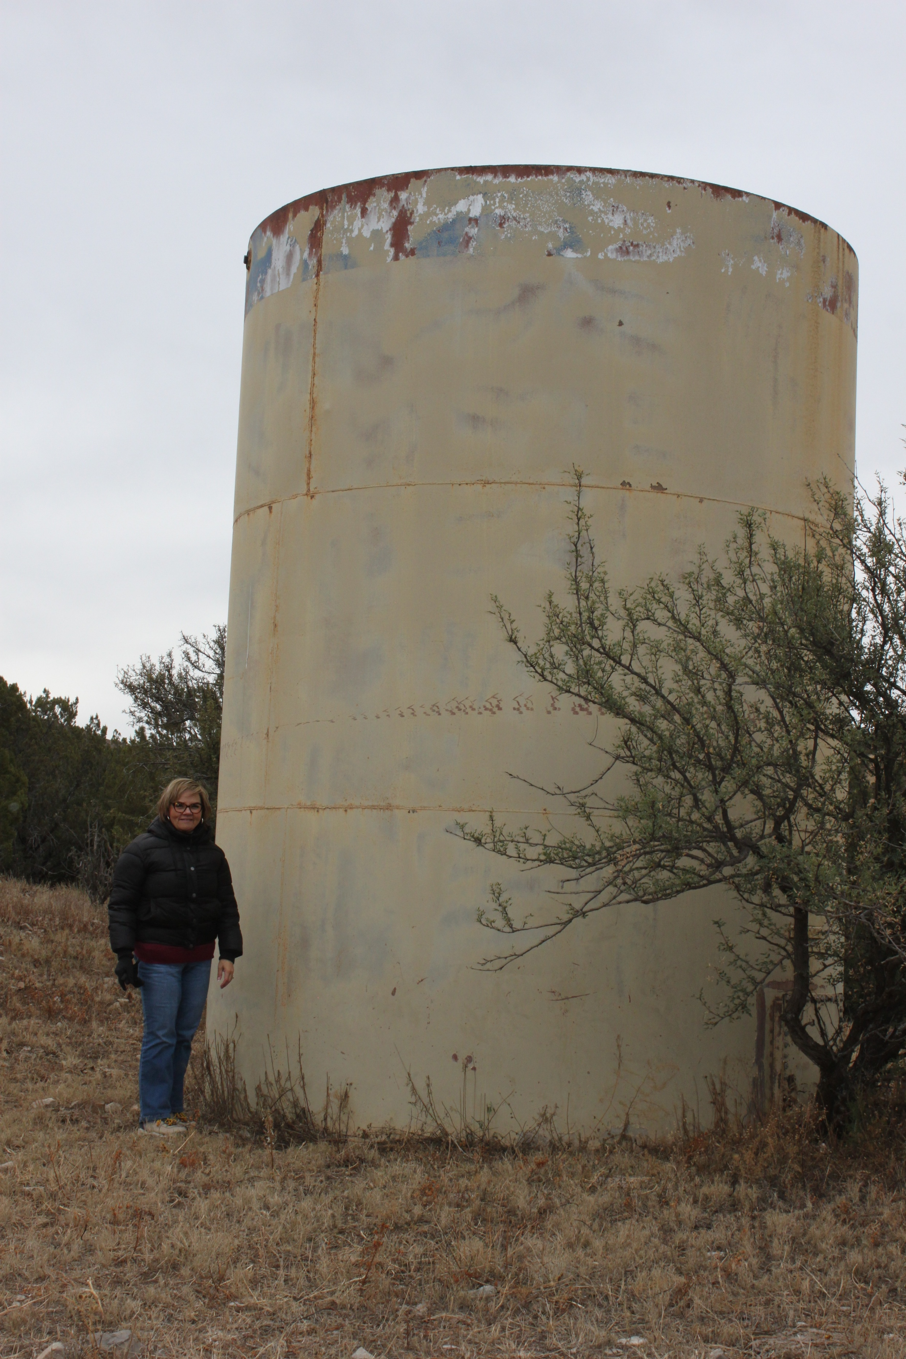
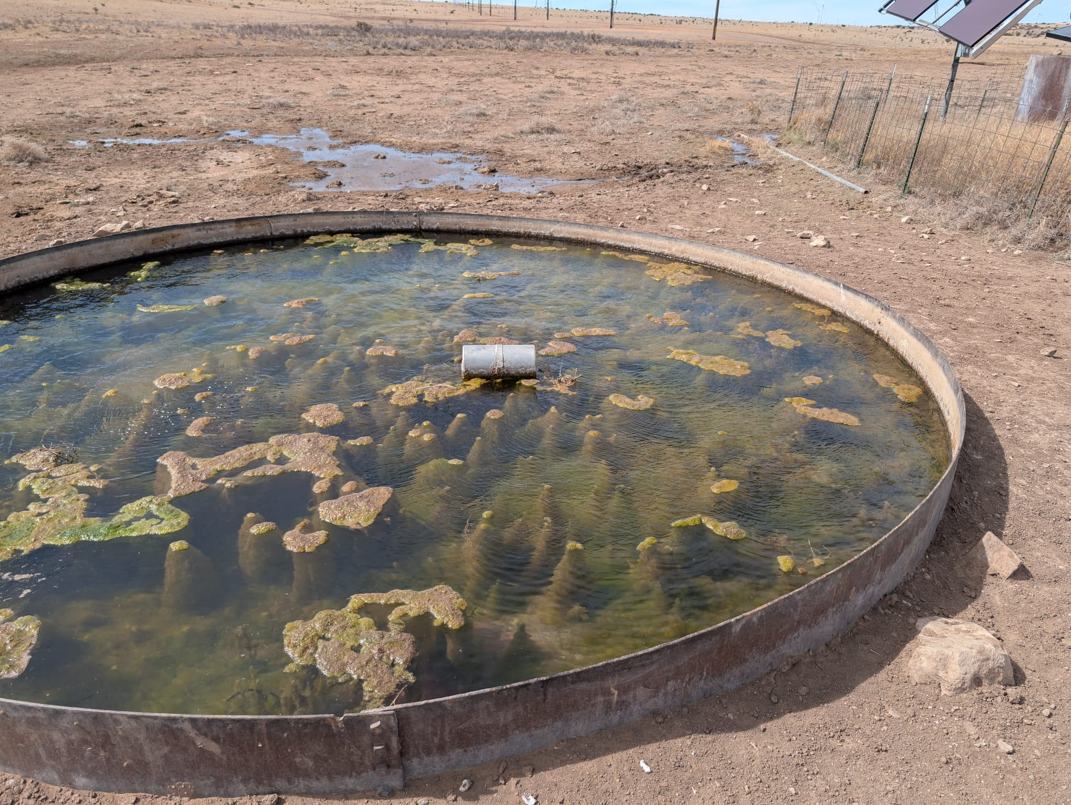

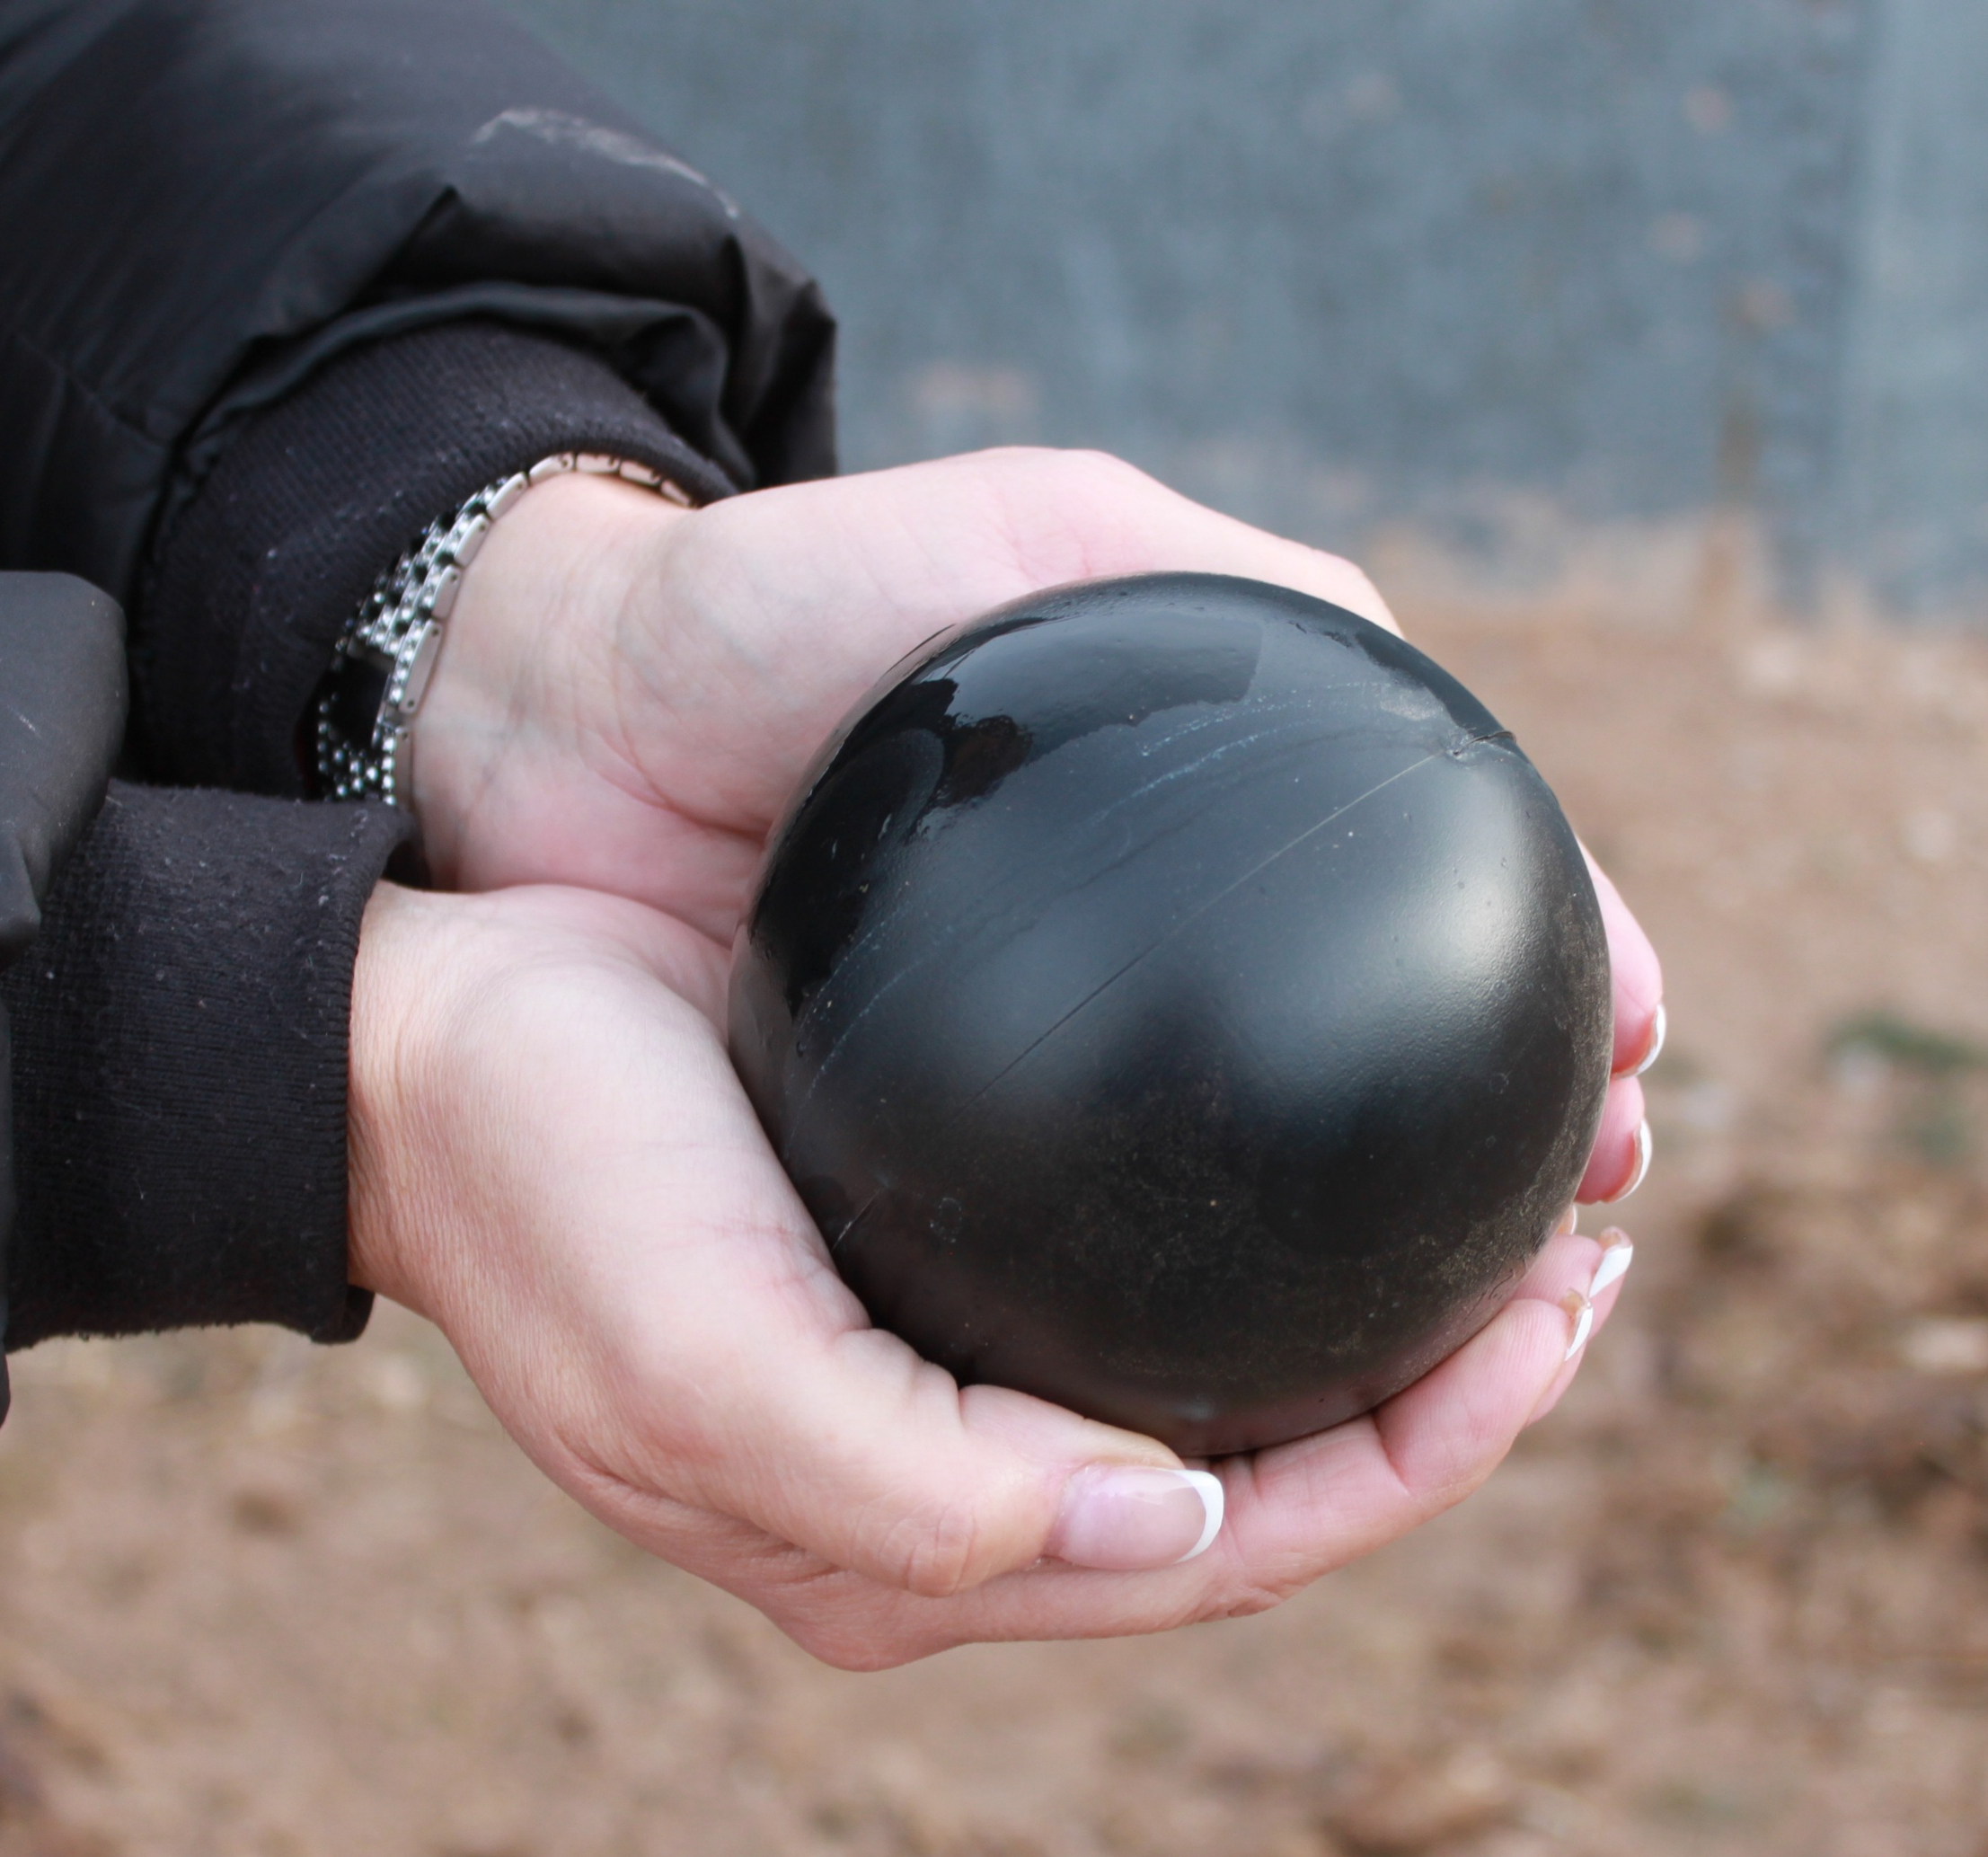
Before: Old rusty tank scheduled for replacement
Information about water levels and evaporation sent to app on phone
In process: New pipe will bring water to needed areas of the farm
Before: shade balls will improve water quality
Shade balls in a drinker

Slide 8
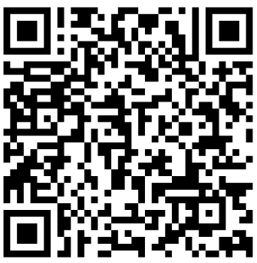
Request for Applications (RFA)
Released on May 5, 2026
Eligible applicants must partner with a rancher or farmer.
A comprehensive list of on-the-ground projects with examples can be found in Appendix A (page 10) of the RFA.
Request for Applications (RFA)

Slide 9
Evaluation Criteria
1.6. Application Evaluation Criteria: Evaluation Factors | Points Available
1. Includes a partnership between a rancher or farmer and a public entity/eligible applicant for funding distribution, project coordination, and reporting. | 10
Clearly demonstrates the ability to manage, save, and efficiently apply limited water resources for agricultural production, supporting water conservation, resilience, and food security. | 10
Clearly identifies the problem that is being addressed with the project approach to improve water conservation, efficiency, or resilience. | 10
Clearly presented goals and objectives with specific descriptions of the project activities, outlined methods, and defined technical approach to produce deliverables that fulfill the project’s objectives and expected results. | 10
Clearly demonstrates potential for broader community impact and community engagement. Community engagement activities may include hosting a site visit, participating in a field day, training or workshops, and contributing to New Mexico Water eNews for sharing experiences, success stories, photos, and videos with other community members. | 10

Slide 10
Evaluation Criteria
Clearly demonstrates capacity, including subcontractors if needed, to design, specify, install, and operate the project, including specialized technical or engineering expertise where required. Applicants also demonstrate that all necessary permits and approvals have been obtained or will be obtained within the project timeline. | 10
Clearly demonstrated project schedule and project fits within timeframe of budgeted appropriation (all project funds must be expended by June 30, 2027). | 10
Water savings and/or water resilience impact clearly stated with an estimate of anticipated benefits. Clearly describes how water savings, withdrawals, or water use will be measured and reported to NM WRRI, including the use of appropriate equipment. Where available, proposals may provide information, data, or reasonable estimates of past water use or withdrawals or demonstrate the capacity to provide such information to support impact assessment and evaluation. | 10
Details a reasonable budget that is aligned with the project scope and reflects good use of public resources. | 10
Includes signed Monitoring and Water Impact Assessment Agreement between the eligible applicant, the partner, and NM WRRI that shows the applicant agrees to interact with the NM WRRI water impact analysis and scientific assessment coordination efforts | 10
Total Points Available | 100

Slide 11
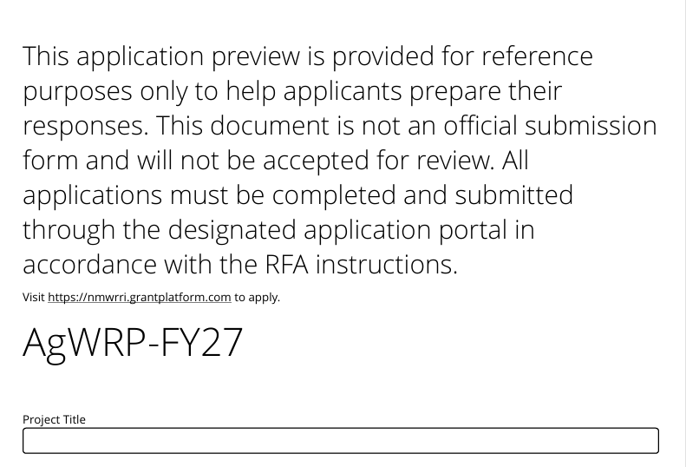
Application
Funding:
Project funding pool of $9 million.
Maximum award of $300,000.
Eligible applicants are not required to contribute to the project costs; however, a 25 percent match is desirable (not to include restricted state or federal funds).
Administrative costs not to exceed 10 percent of the project budget may be included.
Eligible applicants must partner with a rancher or farmer.
Notes:
-Each application is one eligible applicant and one partner, but we can discuss specific cases as needed.
-There will be a separate budget for each partner.

Slide 12
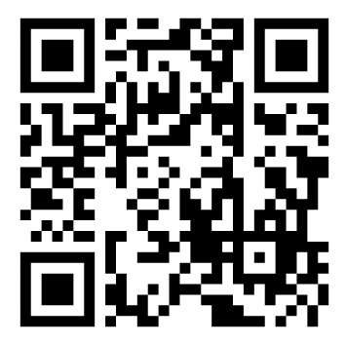
Application
Each project will be submitted by the eligible entity using the application link. More than one application can be submitted from each account.
Applications do not need to be completed at one time, i.e., progress can be saved and the application completed up until when the application closes.
Application will request
Project location
Project background
Project description
Project goals and objectives
Implementation plan
Overall anticipated outcomes and impacts
https://nmwrri.grantplatform.com/
Notes:
-We may recommend other funding sources for large capital equipment purchases.
-Methods: this is where you detail work with a researcher

Slide 13
Application Timeline
Monday, June 29, 2026
Applications must be submitted using the https://nmwrri.grantplatform.com/ platform by 5:00 pm MDT.
Friday, August 14, 2026
Applicants will be notified regarding the status of their application.
Tuesday, September 1, 2026
Projects begin.

Slide 14
Questions
Submit questions to NM WRRI AgWRP (agwrp@nmsu.edu), subject line: “FY27 Agricultural Water Resilience Application Questions.”
Answers will be posted in the FAQs on the NM WRRI AgWRP website.

Slide 15
Thank you!
https://nmwrri.nmsu.edu/nmwrri-agwrp/nmwrri-agwrp.html

